Slide 1


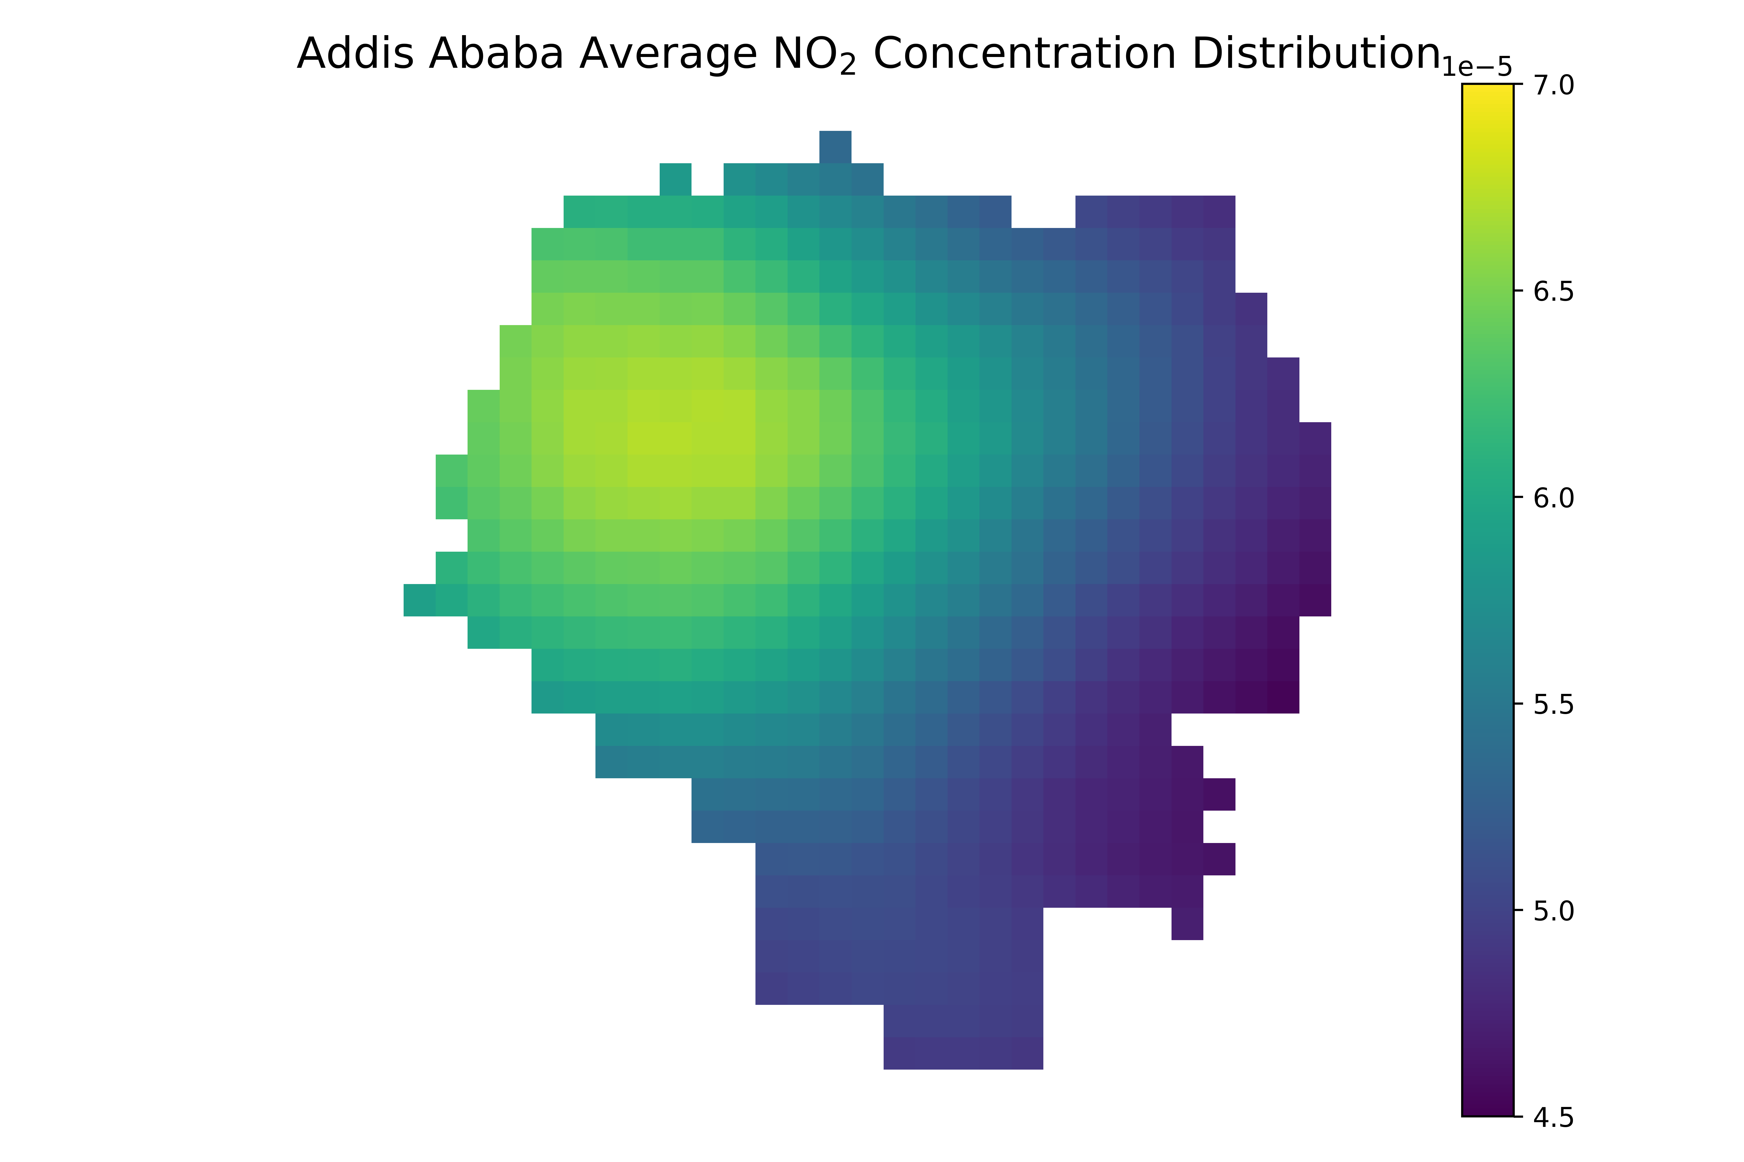
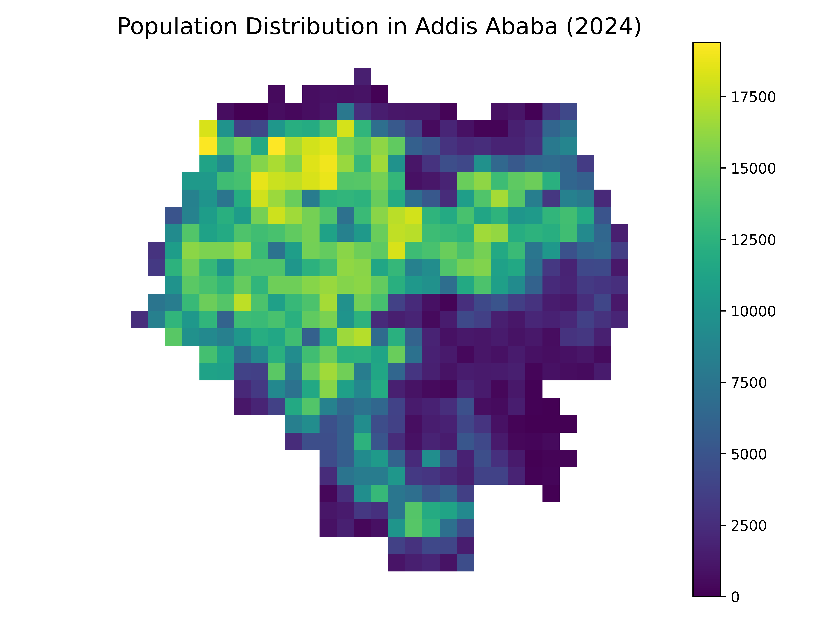
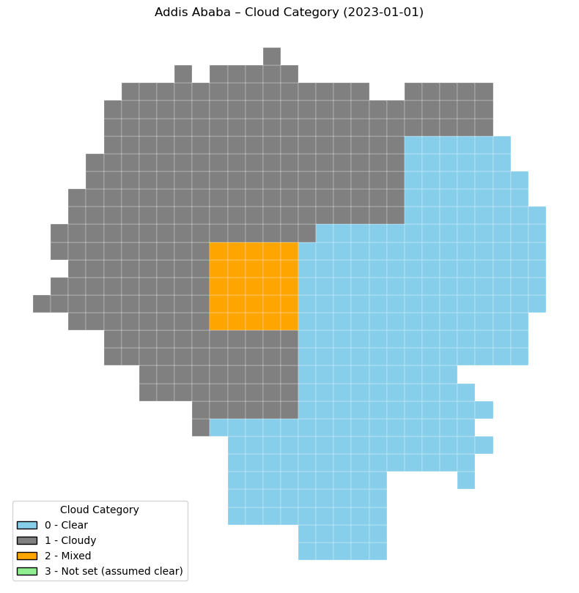
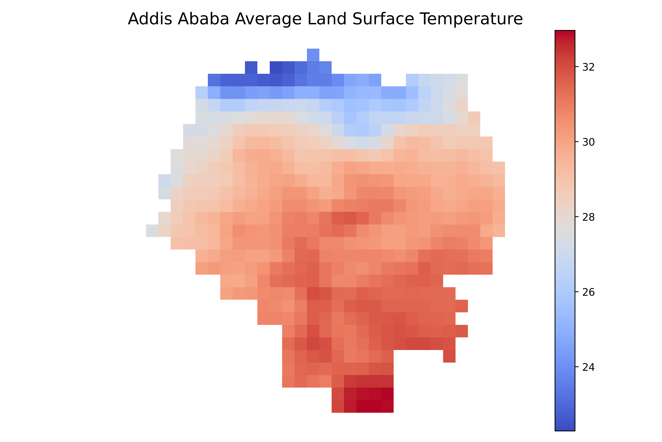
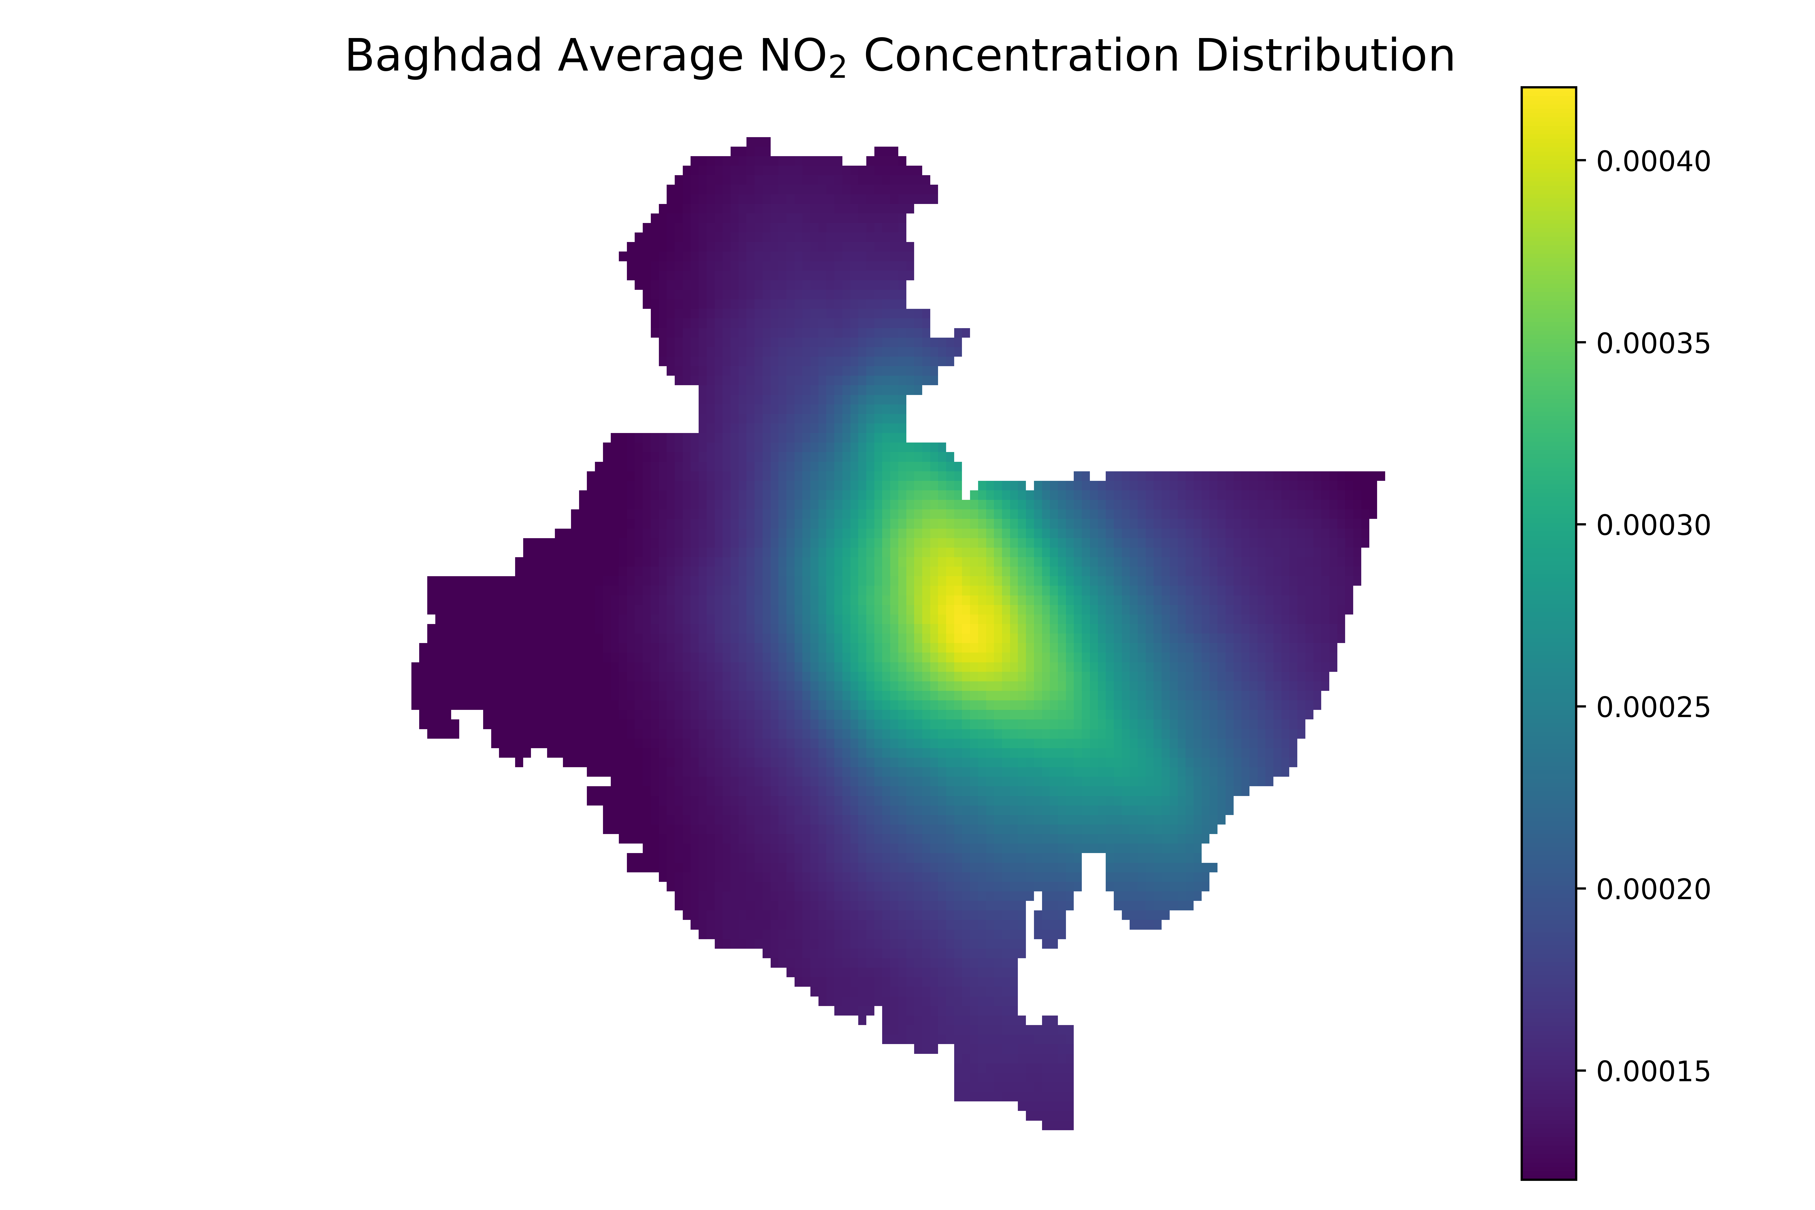
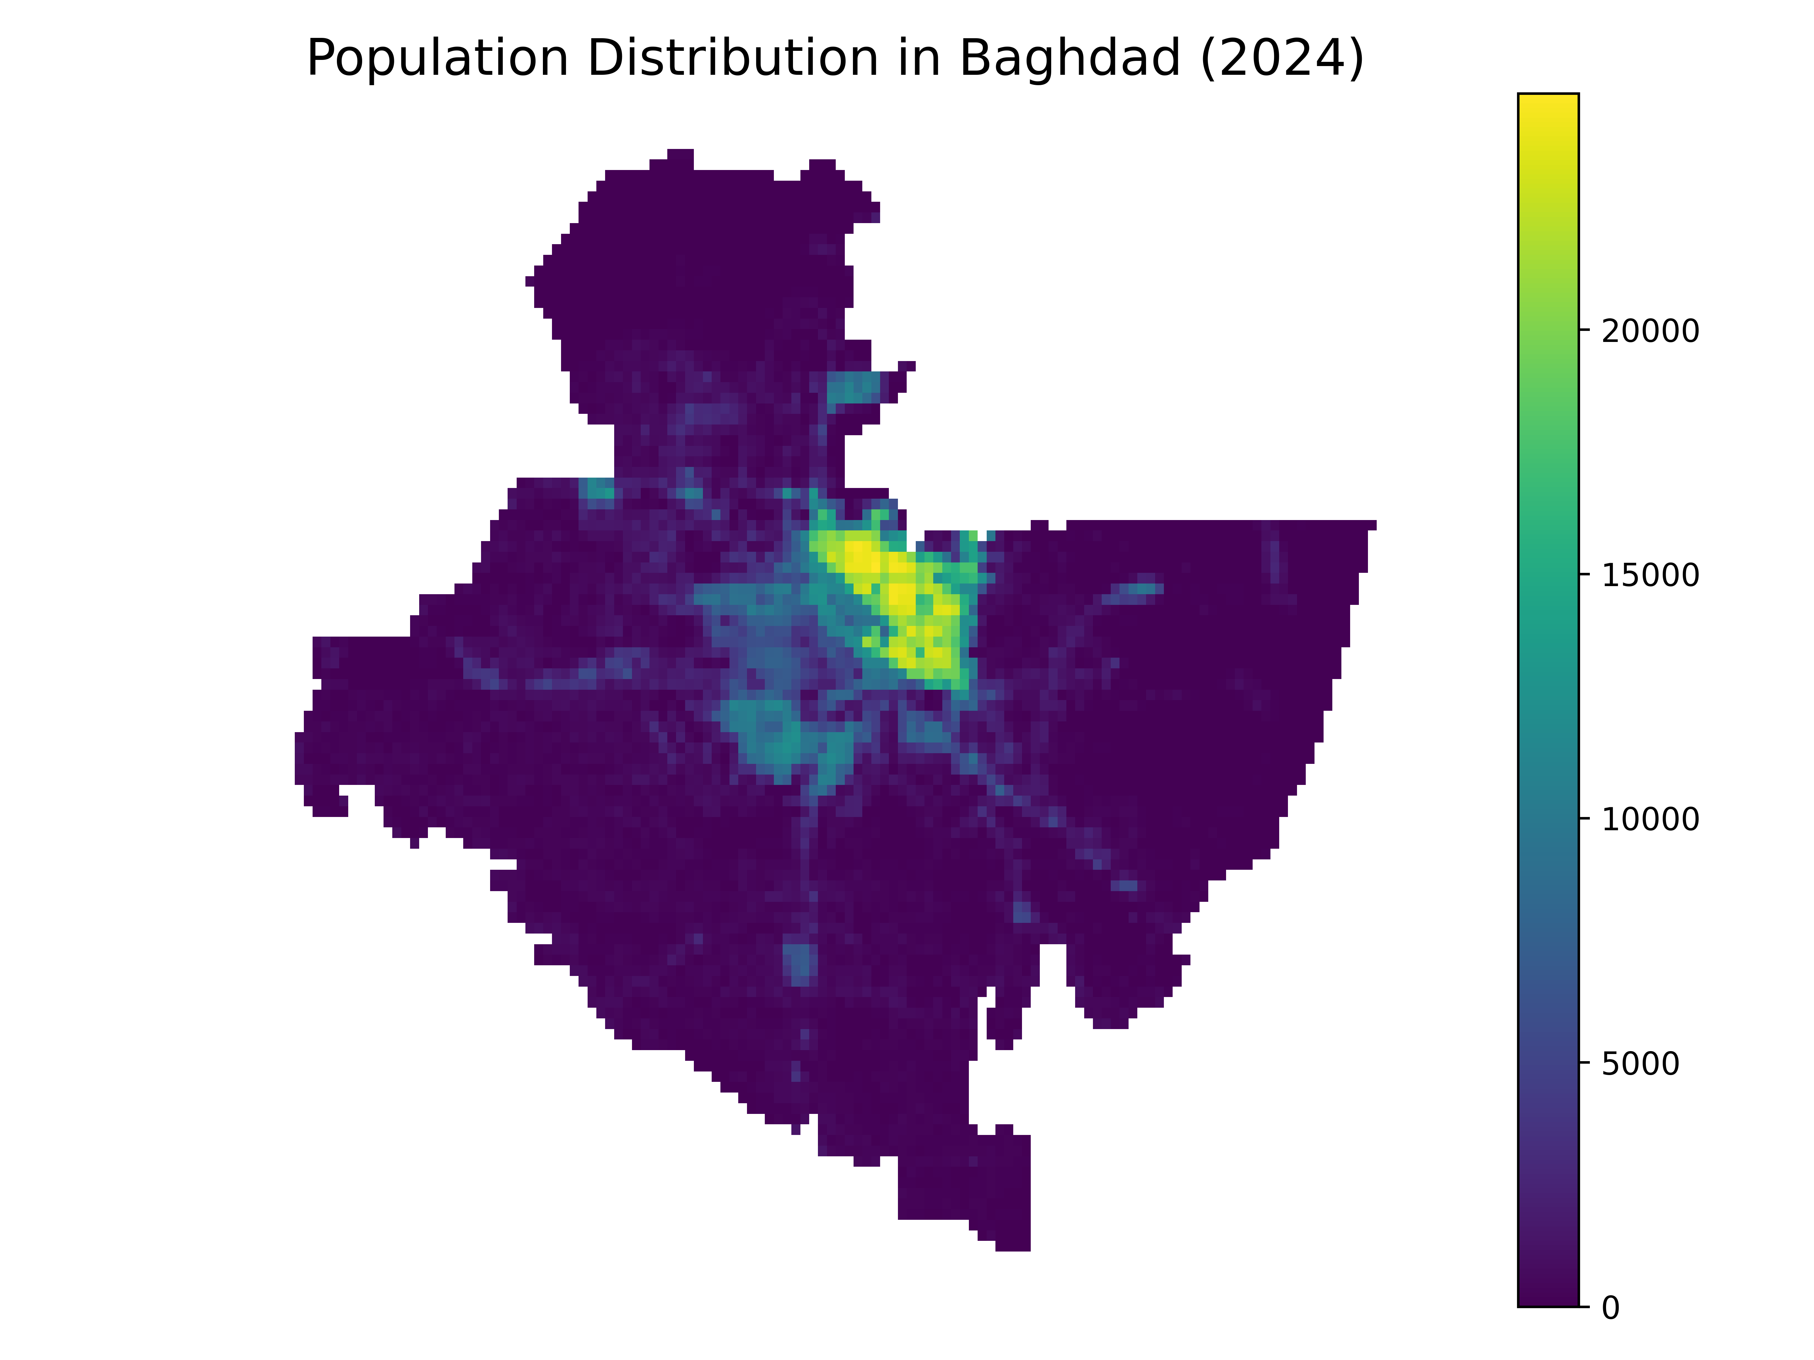
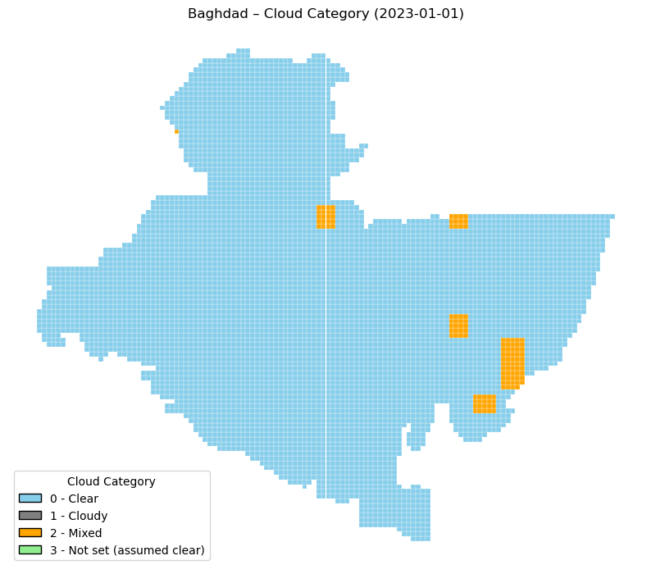
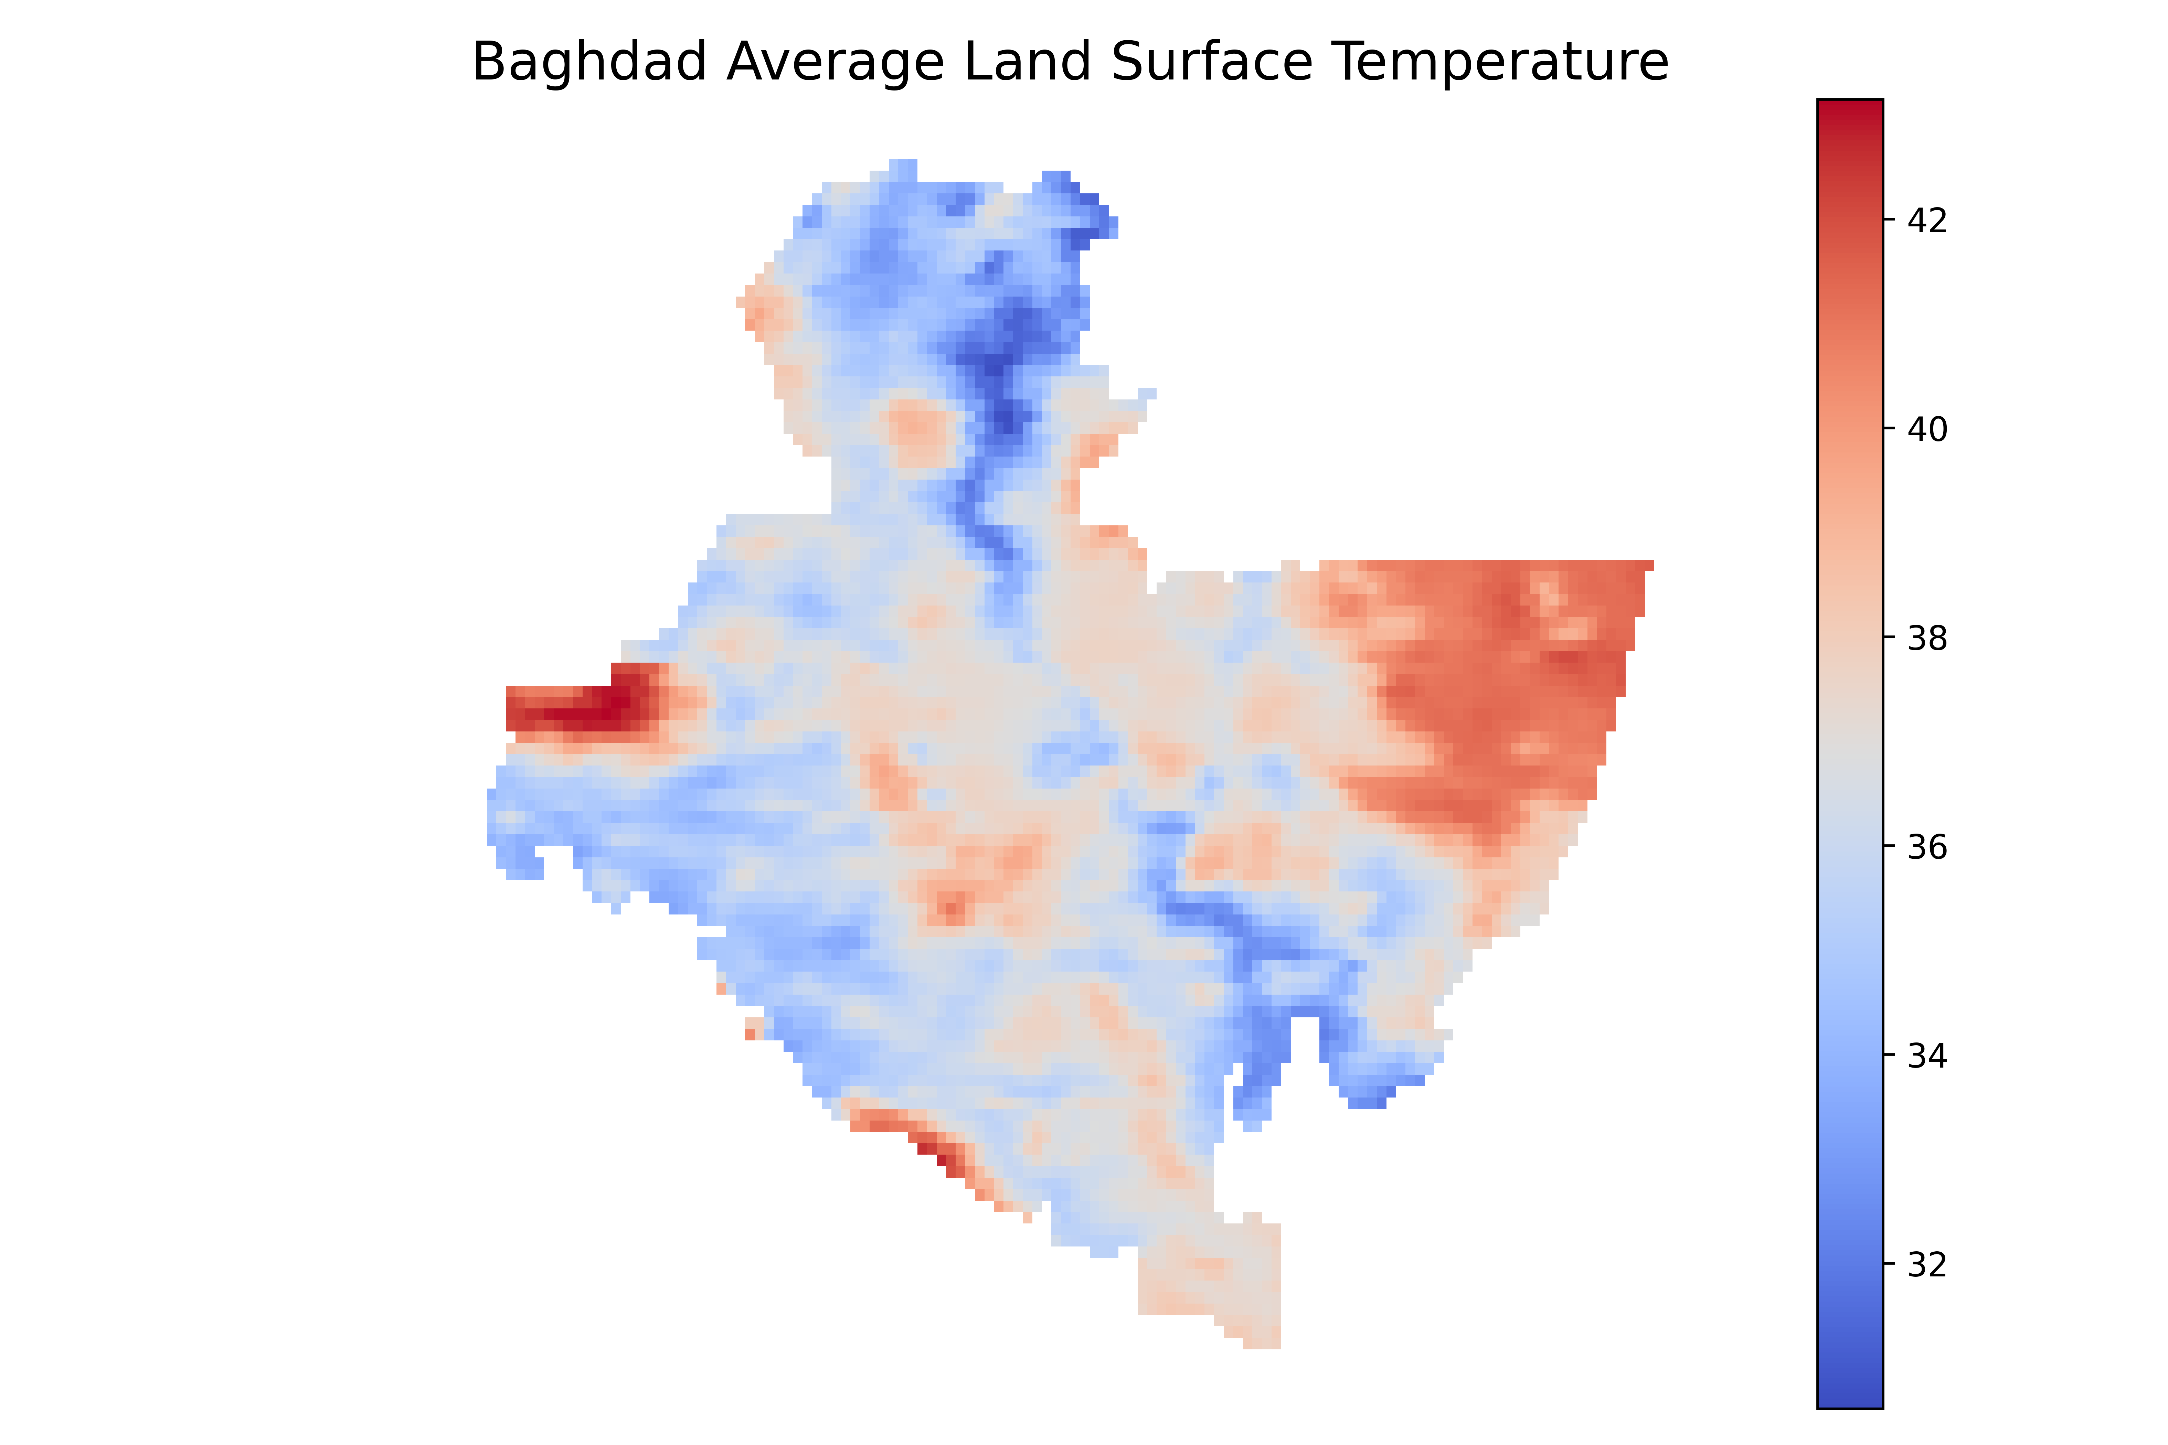
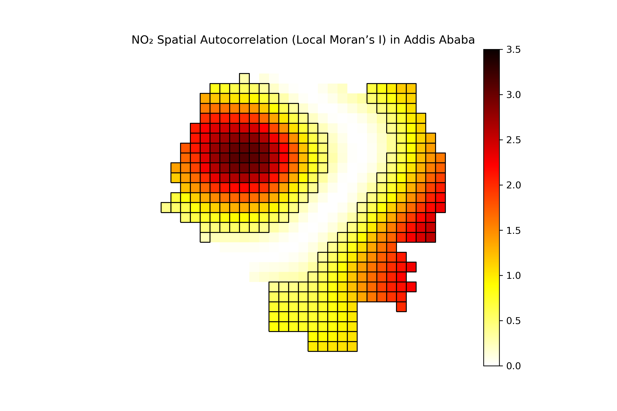
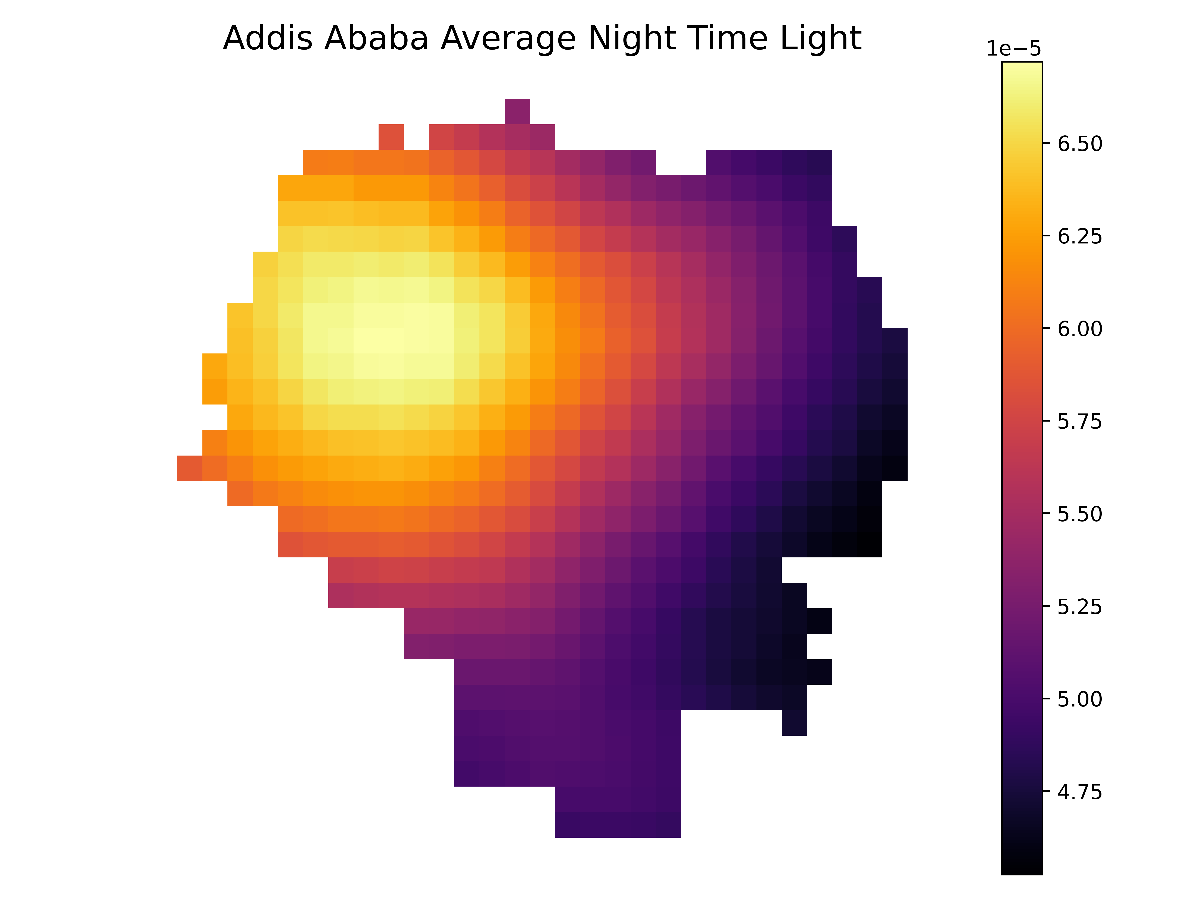
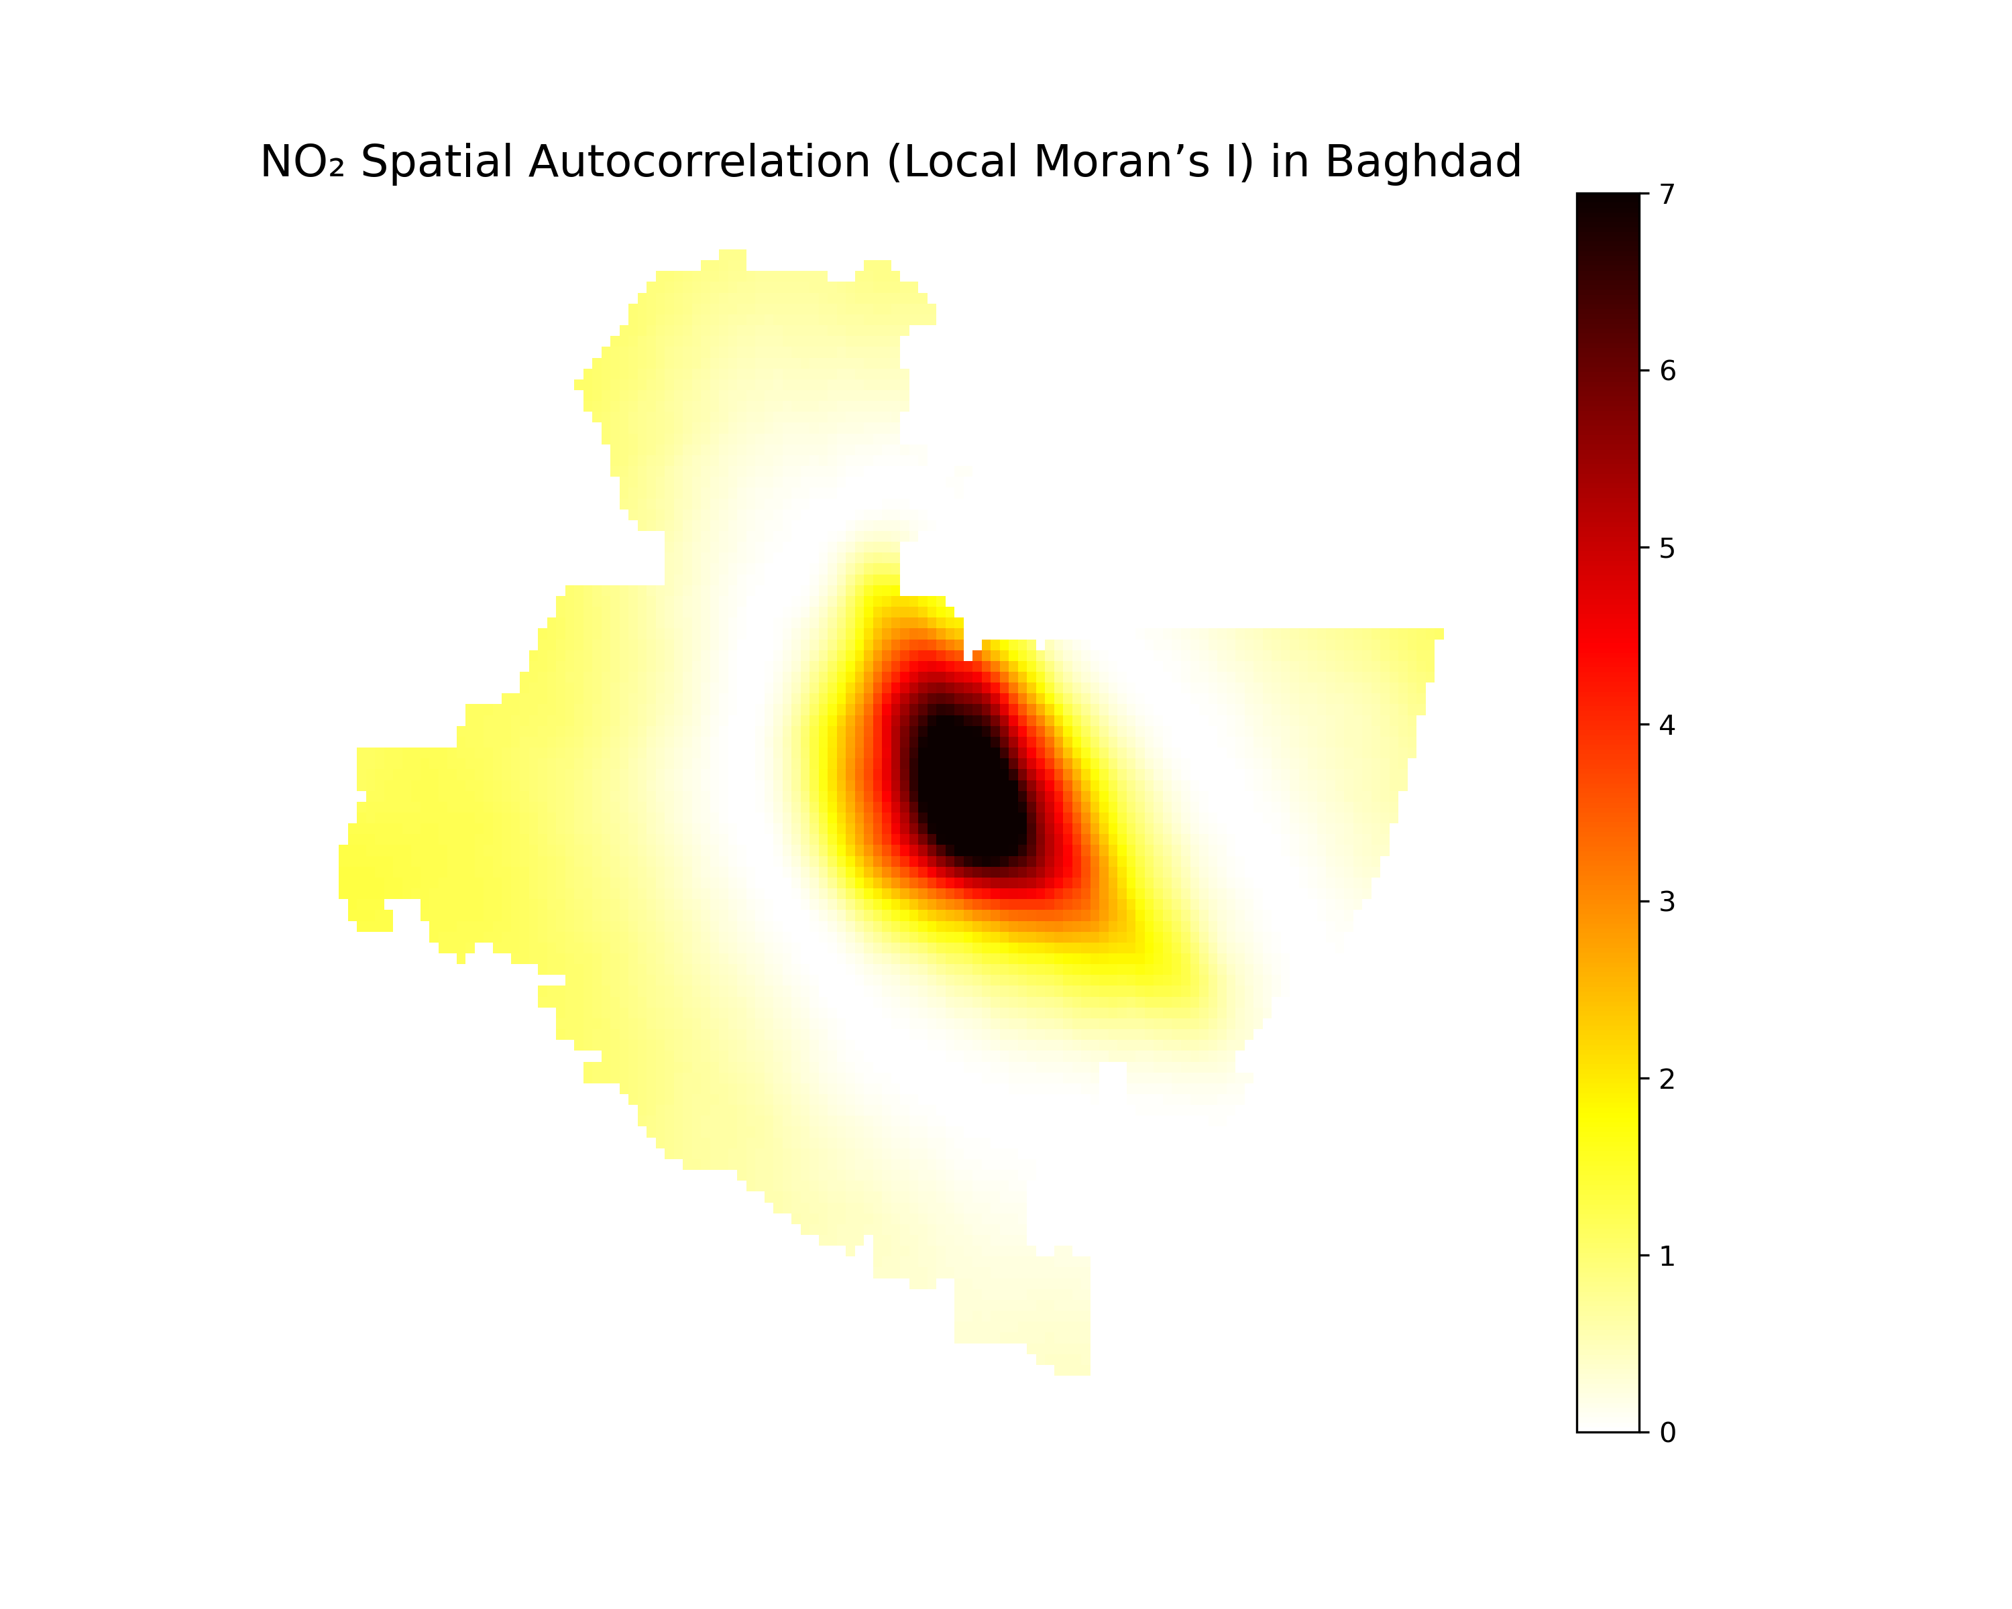
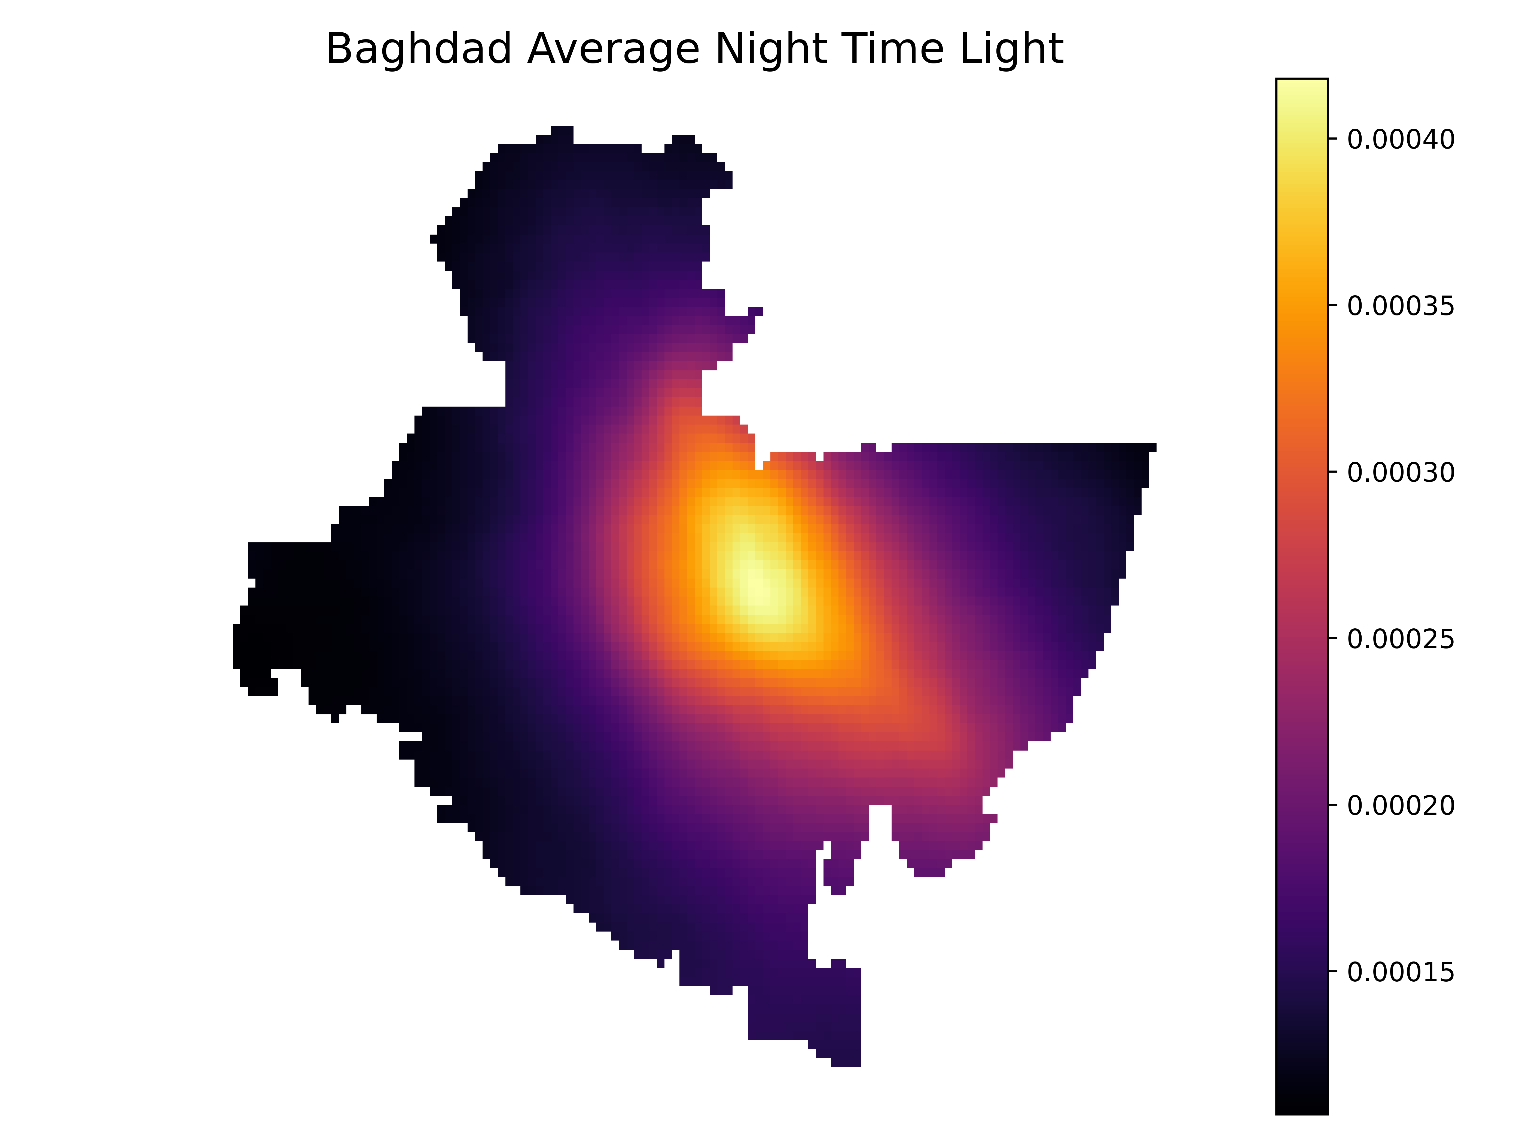
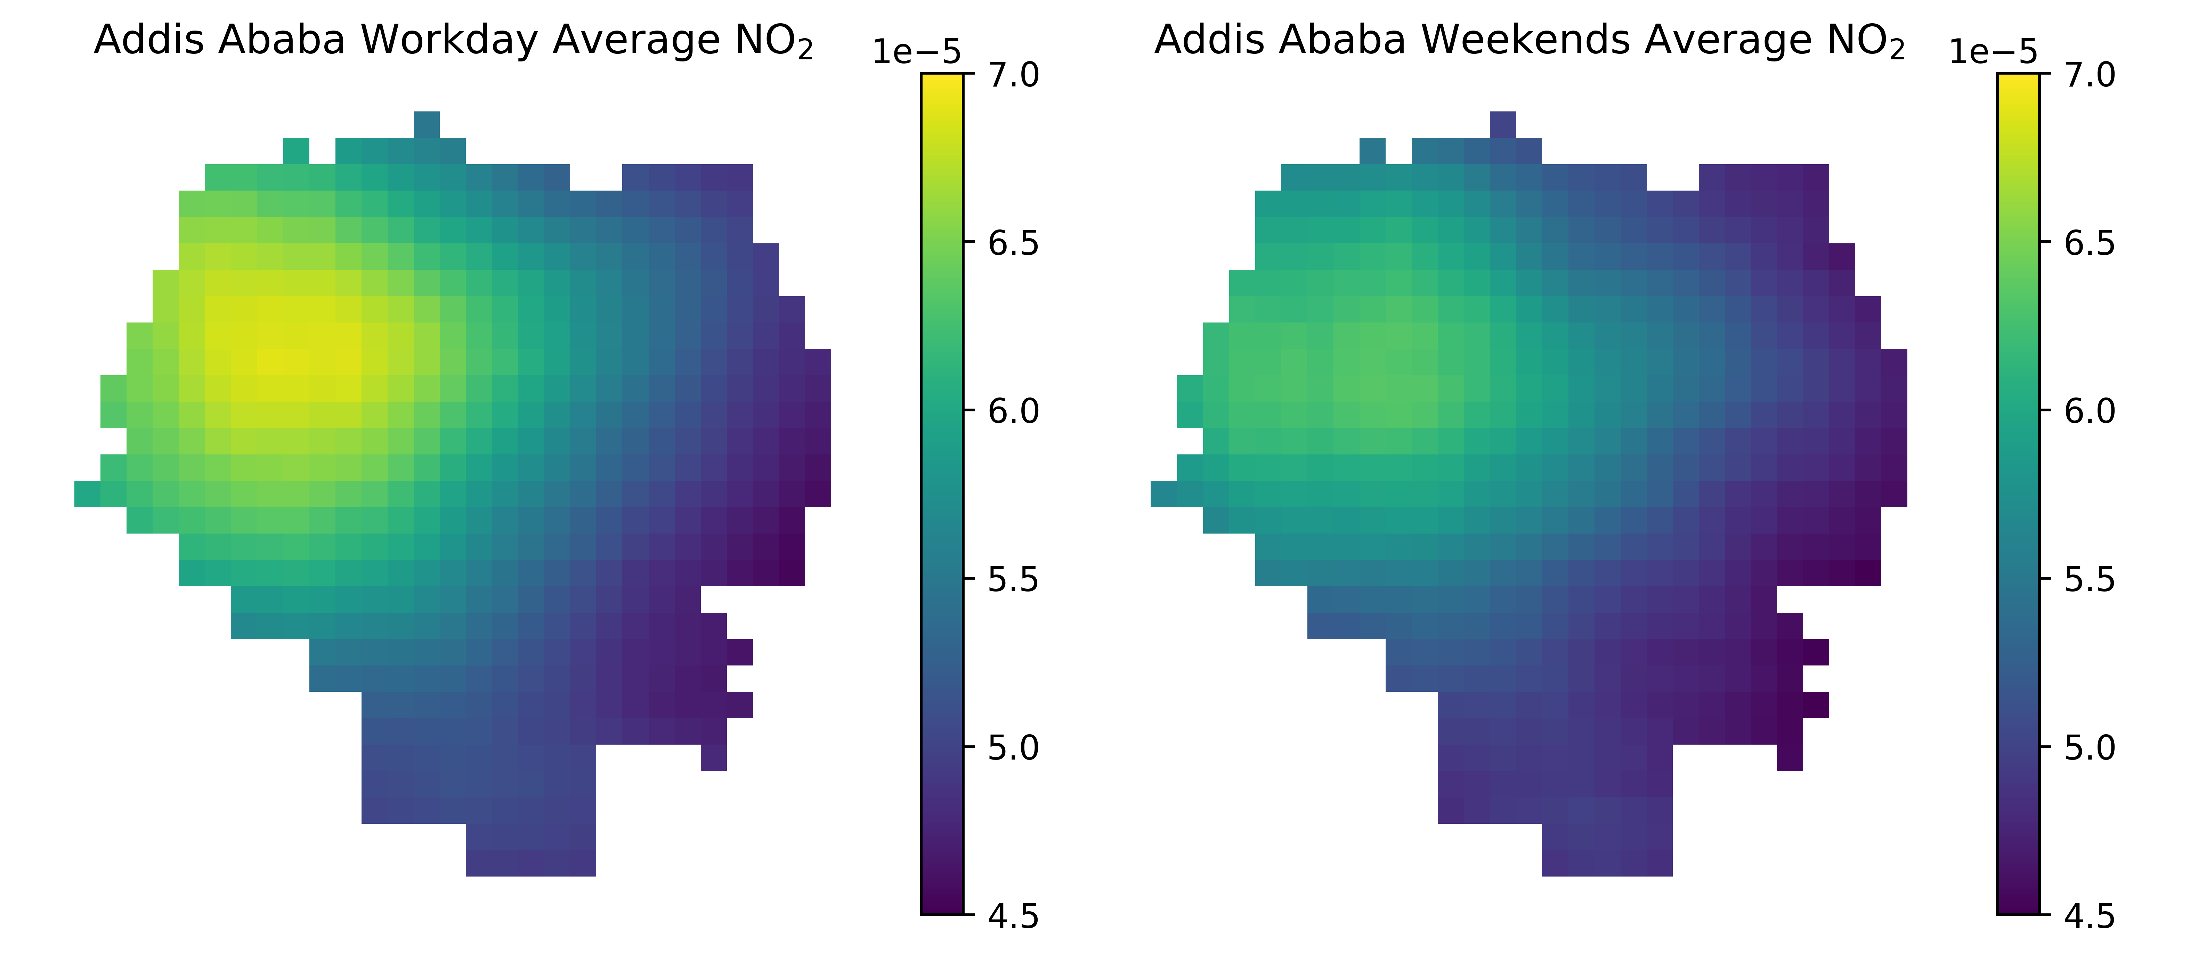
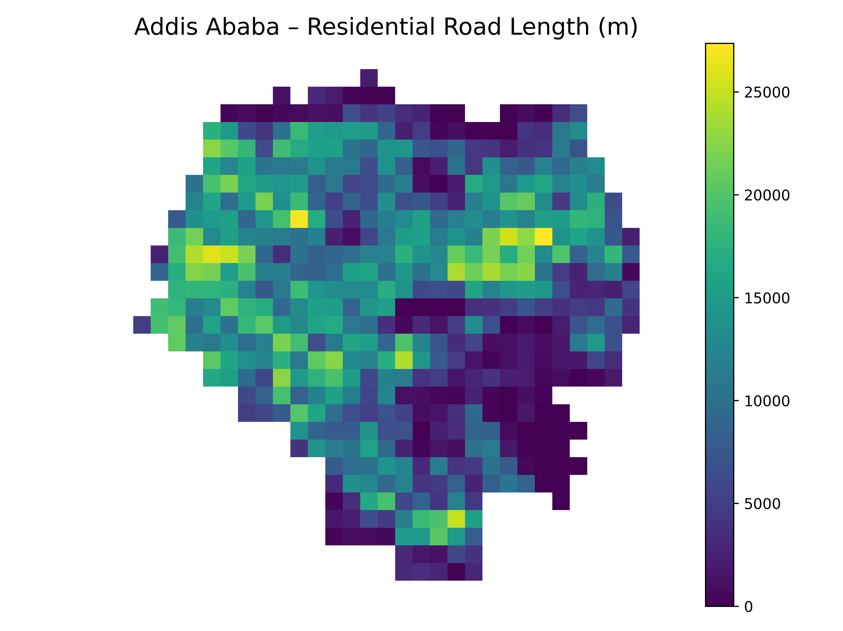
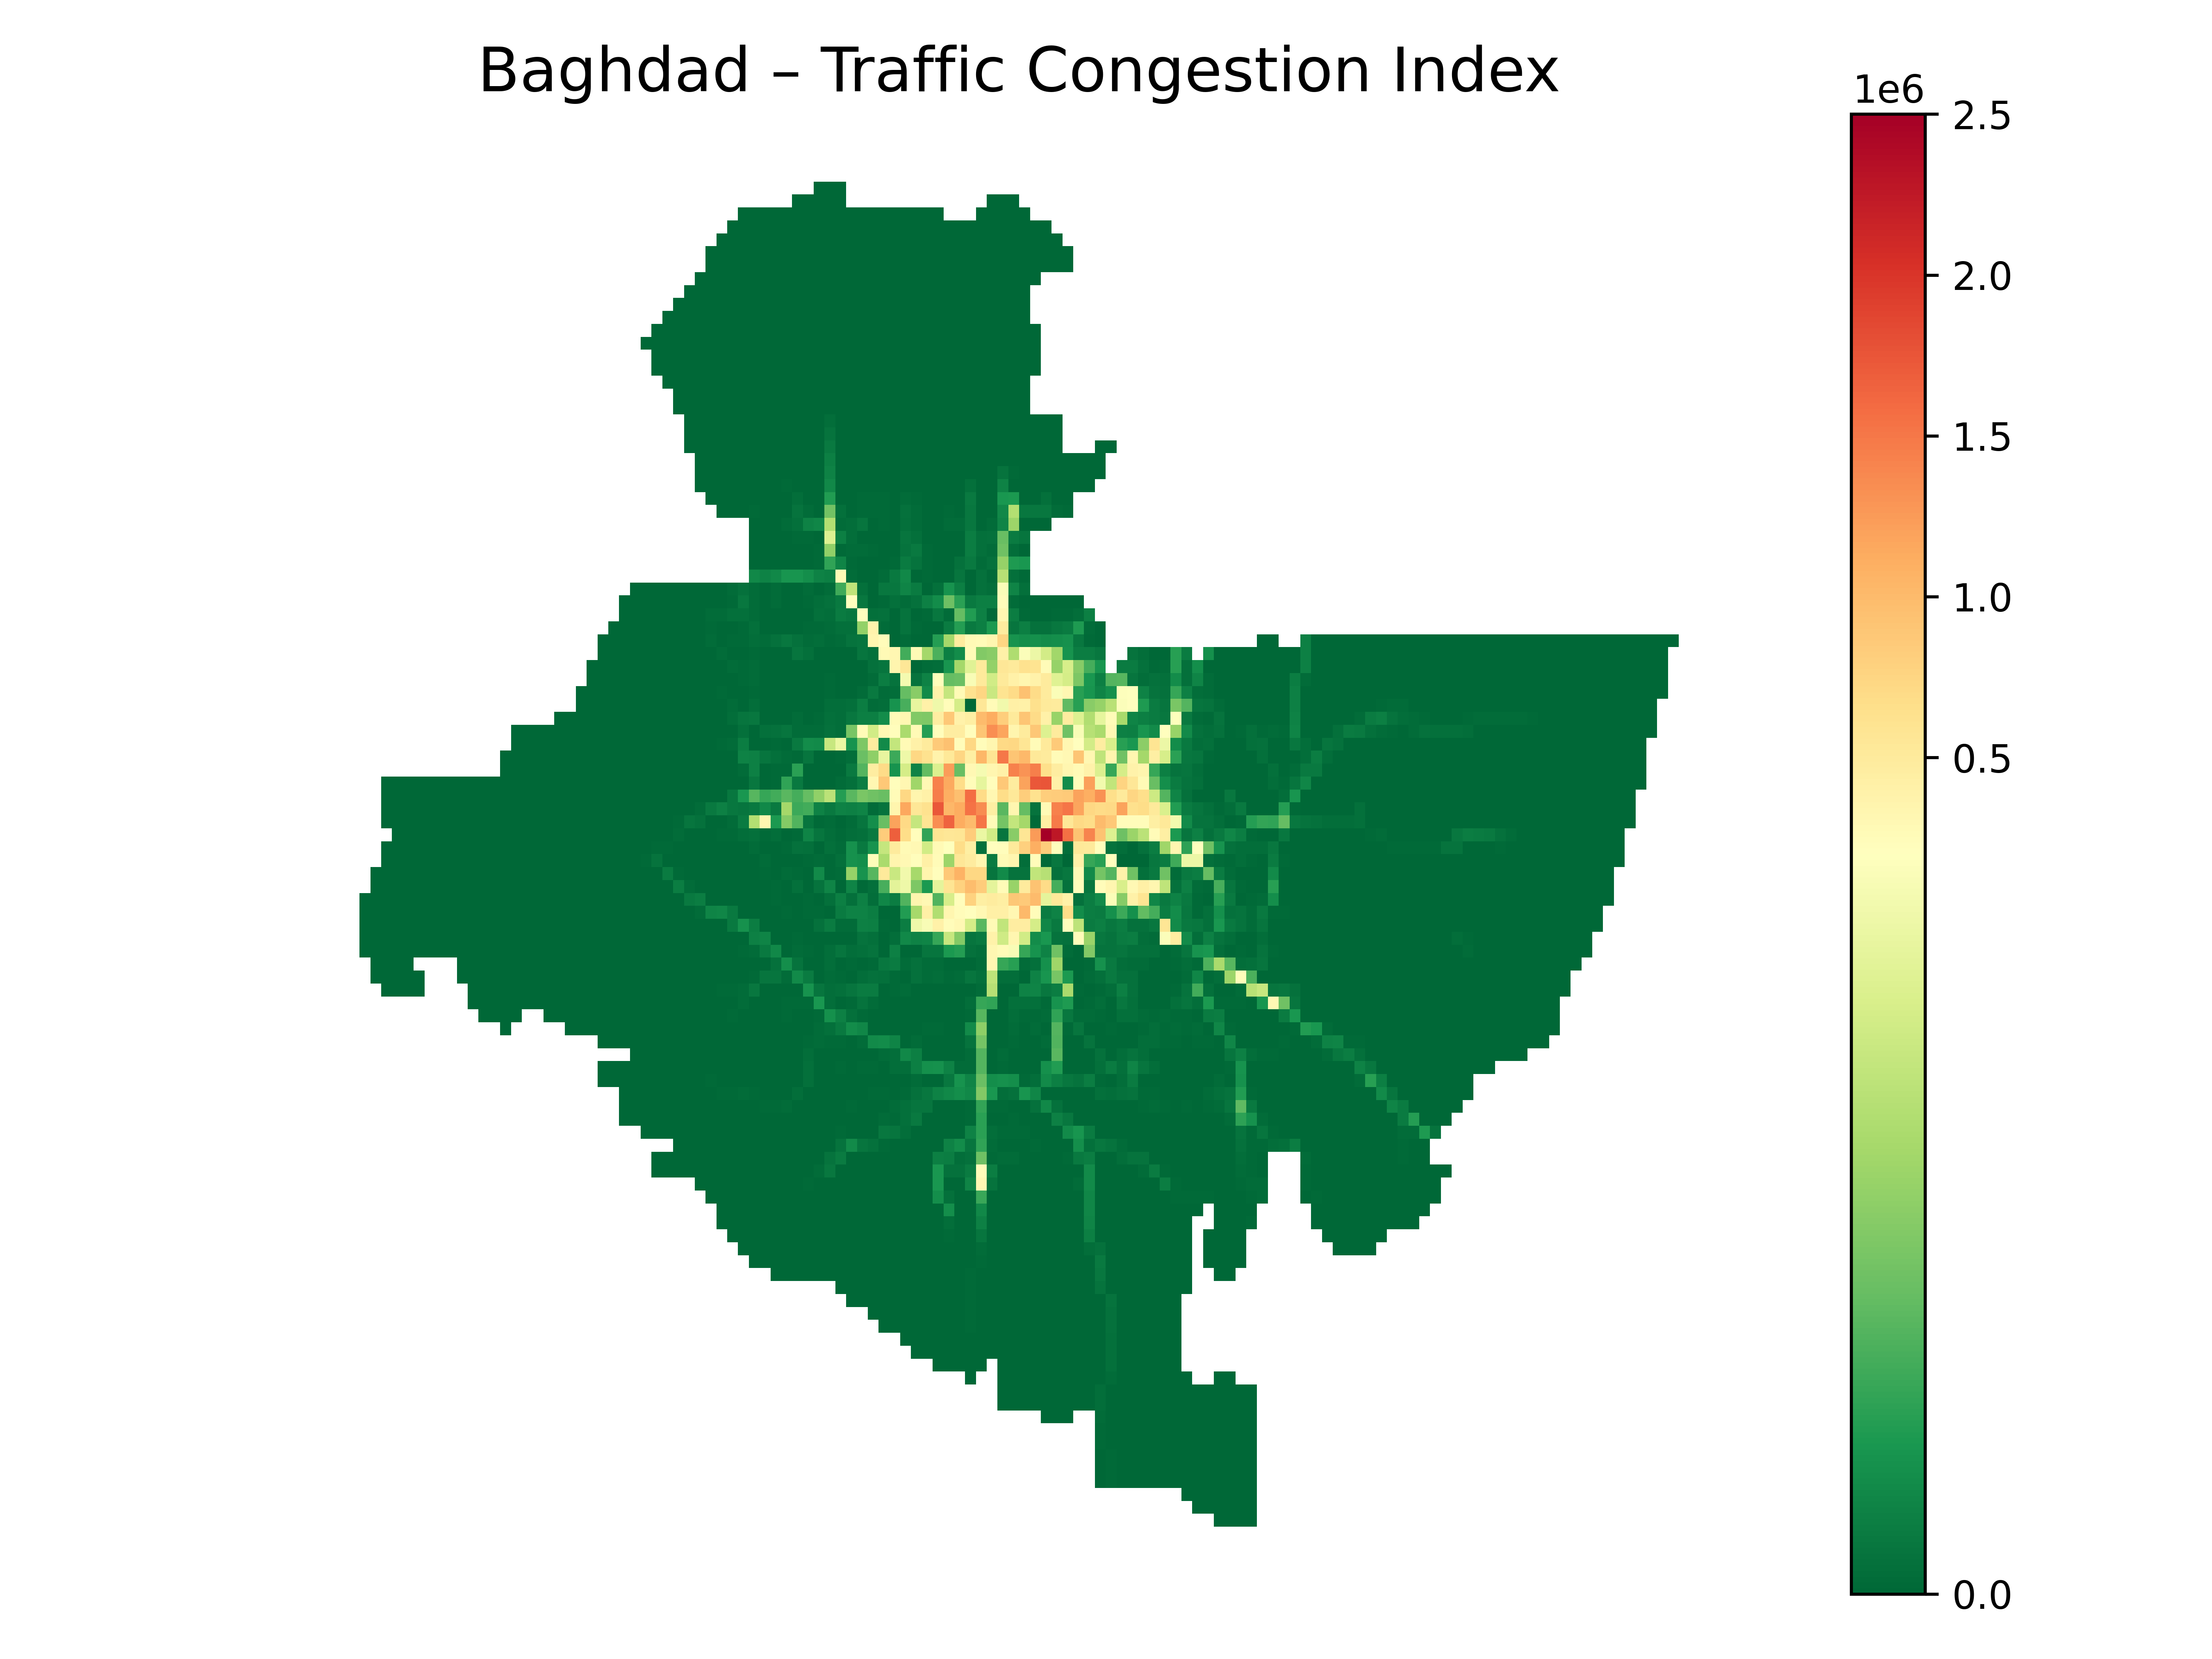

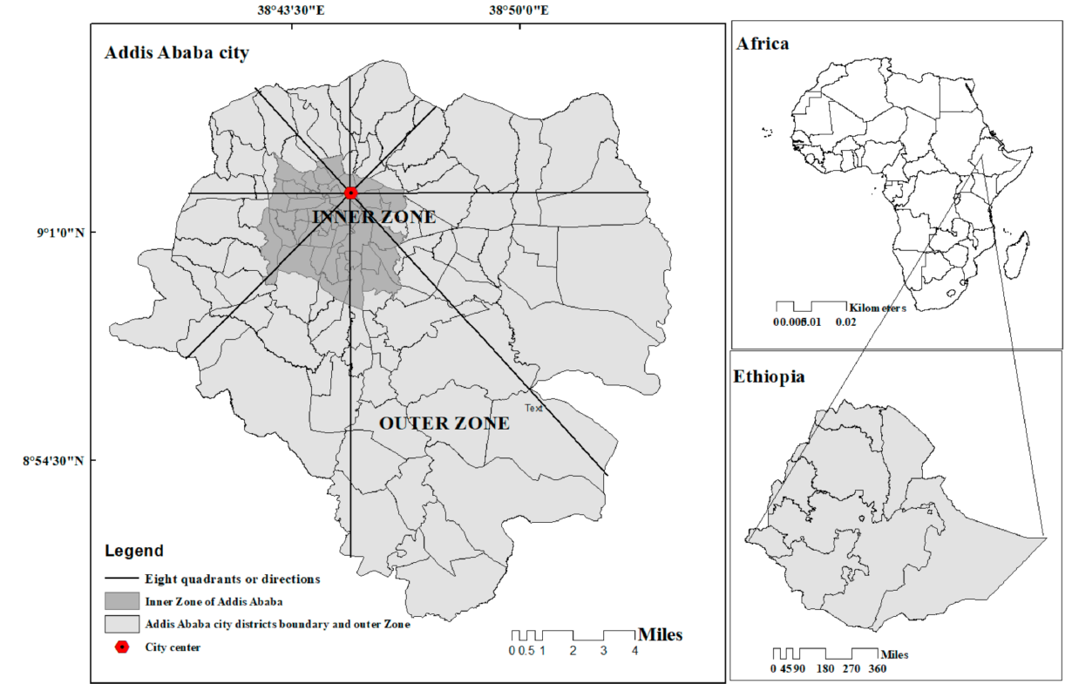
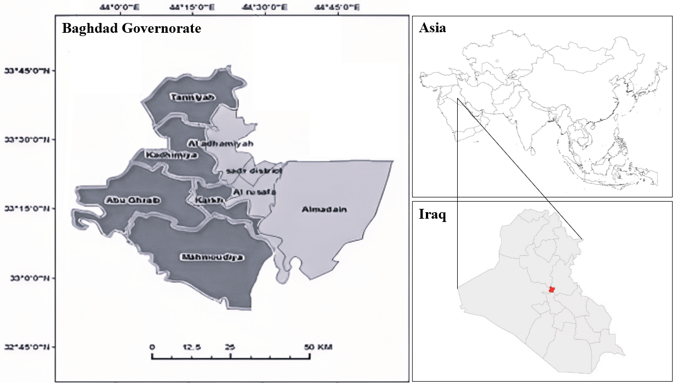
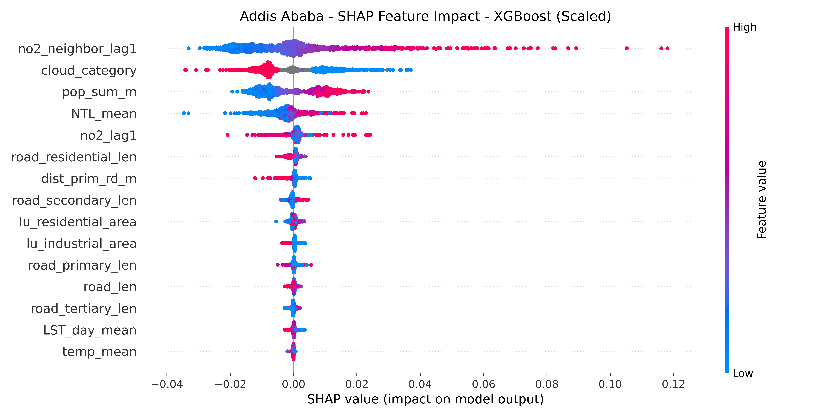
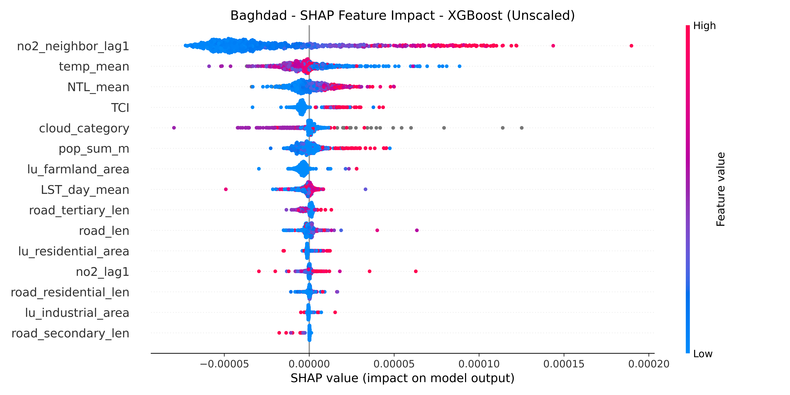
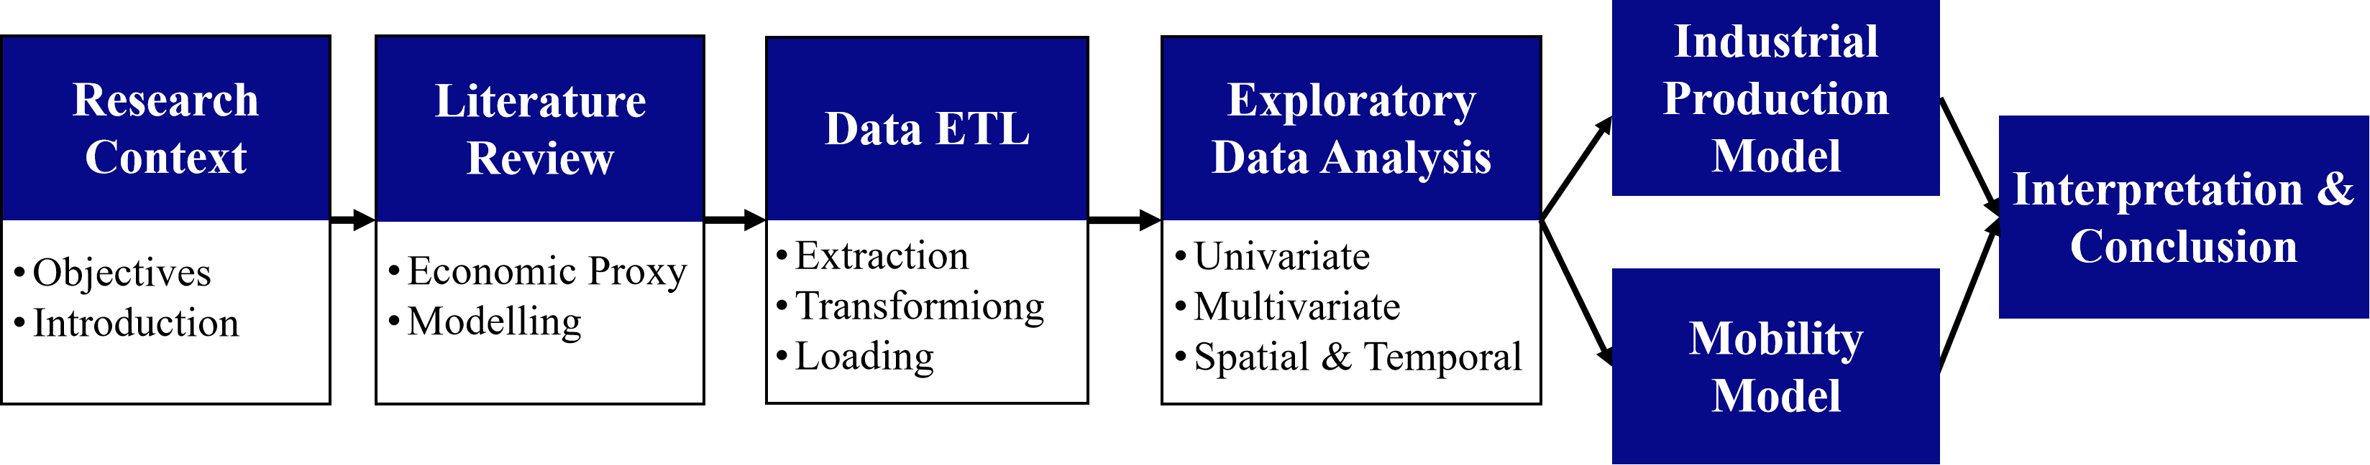
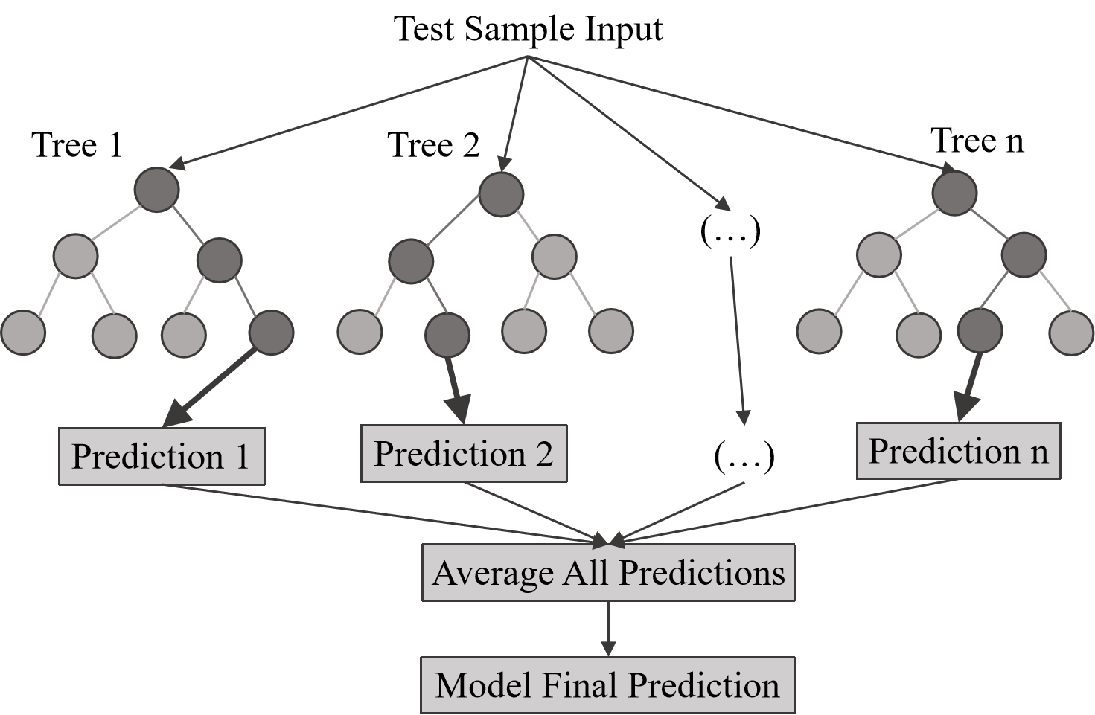
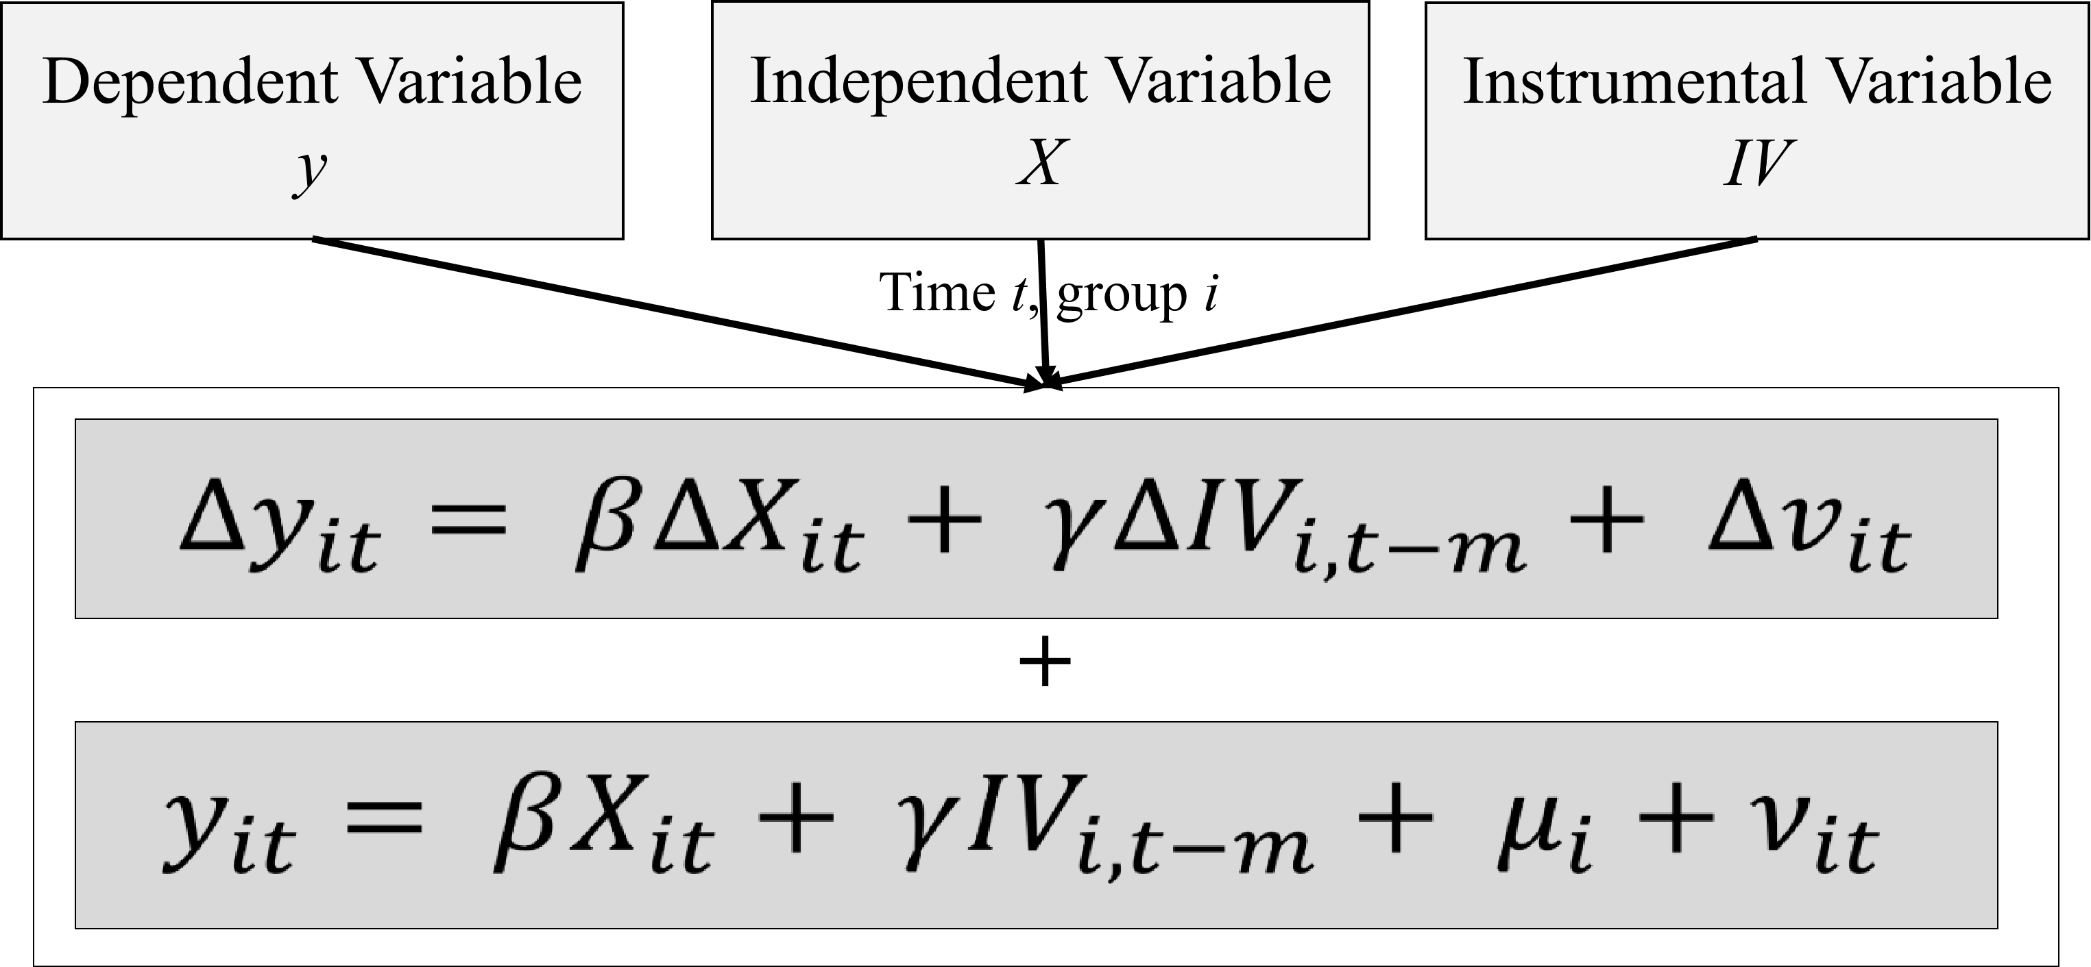


AIR POLLUTION AND ECONOMIC ACTIVITY
Using Nitrogen Dioxide Emissions as a Proxy for Industrial Activity and Mobility
Group1: Ahmed Habeebah, Avasare Kunjal, Lin Jia Syuan, Li Yixuan, Li Yueyang (Amy), Parra Luis, Twumasi Rosemary, Zhou WenHan
Overview
Exploratory Data Analysis
Background
In many low- and middle-income countries, subnational GDP data is often delayed, sparse, or unreliable, while existing satellite-based proxies such as nighttime lights and mobility, though offering high-frequency insights, have notable limitations.
As a globally accessible and timely data source, NO₂ is emerging as a promising proxy for economic trends, especially in data-poor regions. Our research investigates whether satellite-derived NO₂ can reliably track urban economic activity—particularly that driven by industry and mobility—at the sub-city level.
Project Objective
NO₂ Source Attribution: Attribute satellite-observed NO₂ concentrations to its main sources—industrial pollution and mobility—across spatial and temporal dimensions.
Macro-Level Validation: Develop macro-level models to validate the relationship between NO₂ and economic activity.
Project Reasearch Area
Capital of Ethiopia: Addis Ababa & Capital of Iraq: Baghdad
NO₂ Distribution
Socio-Economic
Addis Ababa
Baghdad
Climate Feature
NO₂ Distribution
Socio-Economic
Climate Data
Source: Sentinel-5P
Source: WorldPop
Source: MODIS
Source: MODIS
Source: Sentinel-5P
Source: WorldPop
Source: MODIS
Source: MODIS
Correlation Matrix
Correlation Matrix
Source: NASA VIIRS BlackMarble
Source: NASA VIIRS BlackMarble
NO₂ on Workday/Weekend
Source: OpenStreetMap
Source: Waze Data
Source: OpenStreetMap
1 distribution
2 Spatial Autocorrelation
3 Day type aggregation
Results
Addis Ababa
Baghdad
Addis Ababa / አዲስ አበባ
Baghdad / بغداد
NO₂ Explanatory Model
Key Insights
NO₂ pollution exhibits significant spatial diffusion characteristics
Human activity intensity is a major driving force behind NO₂ pollution. In particular, nighttime light (NTL), serving as a composite proxy for nighttime economic and traffic activity, indicates a sustained contribution from nocturnal emission sources.
Meteorological and transportation factors also play a critical role in pollution dynamics.
NO₂ Explanatory Model
Key Insights
Similar to other pollutants, NO₂ exhibits spatial diffusion patterns.
Nighttime light intensity reflects nighttime economic and traffic contributions to NO₂, while climate factors like land temperature and cloud cover have complex effects.
Mobility-related features, especially the Traffic Congestion Index (TCI), show a strong and consistent correlation with NO₂ concentrations.
Project Flowchart
Industrial Production Model
Mobility Model
Methodology
The System GMM model is selected to estimate the relationship between NO₂ and industrial production.
In the absence of GDP data, disaggregated export data was used as a proxy for industrial production.
The model passed the Sargan and AB AR(1) / (2) tests, confirming its validity. NO₂ is found to be a viable proxy for measuring changes in industrial production.
Multiple statistical models were constructed to verify the relationship between satellite-derived NO₂ and mobility, represented by the Traffic Congestion Index (TCI) in Baghdad.
Based on model performance (R²) and complexity, the Ordinary Least Squares (OLS) model performed best.
The best OLS model reached an R² of 0.80, confirming NO₂ as a real-time proxy for congestion.
NO₂ Explanatory Model
Industrial Production Model & Mobility Model
Modeling Level:
Mesh grid (0.025° ~ 2.78km) Micro Level
Resolution: Daily & Cell Unit
Model Selection - Maching Learning:
Tree-based Regression Models
Advantage:
Tree-based Regression Nonlinear Modeling Capability
High Interpretability
Robustness
Effective for High-Dimensional Data
Model Structure:
Modeling Level:
Administrative Level 3 Macro Level
Resolution: Monthly & Sub-district
Model Selection - Statistical Model:
Ordinary Least Squares, OLS
Fixed Effects & Random Effects
System and Difference Generalised Method of Moments, GMM *
* best-performing model
Advantage:
More Stable with Small Samples
Strong Interpretability
Theory-Driven
Model Structure:
Variable | Elasticity | Interpretation
NO₂(mole m⁻²) | 1.7849 | A 1% increase in NO₂ is associated with a 1.78% increase in export values.
Nightlights (intensity, sum) | 2.9627 | A 1% increase in NO₂ is associated with a 2.96% increase in export values.
Points of Interest (numeric, count) | 6.5591 | Denser POIs associated with higher exports.
(Commercial area)*NO₂ | -1.0064 | Commercial areas with high NO₂ negatively associated with exports.
(Industrial area)*NO₂ | -2.1184 | Industrial areas with high NO₂ negatively associated with exports.
Variable | Elasticity | Interpretation
NO₂ (mole m⁻²) | +0.25 | A 1 % rise in average NO₂ is associated with a 0.25 % rise in monthly congestion.
Points of Interest (numeric, count) | +0.42 | Adding 1 % more POIs (e.g. shops, services) raises congestion by 0.42 %.
Land-surface temperature (day, °C) | –1.47 | A 1 % hotter average daytime LST cuts congestion by 1.5 % (fewer trips in extreme heat).
Primary-road length (km) | –0.65 | Extra primary-road supply eases congestion (elasticity –0.65).
1 distribution
2 Spatial Autocorrelation
3 Day type aggregation
Acknowledgement
Conclusion
The authors would like to thank Professor Marc Stettler and Liang Ma of Imperial College London as well as Sahiti Sarva and Maria Sol Tadeo of the World Bank for their assistance and support.
NO₂ is produced and influenced by natural and anthropogenic sources such as vehicular emissions, industrial activity, and meteorological effects. In Baghdad, NO₂ levels of neighbouring regions, morning surface temperature, congestion, and nightlights are all highly associated with NO₂ values. In Addis Ababa, cloud cover and population show high association as well.
Macro-level regression models showed a strong positive relation between NO₂ levels and economic activity indicators such as TCI and exports. In both models, NO₂ consistently emerged as one of the most informative features and excluding it greatly reduced model explanatory power.
In fragile countries that have a lack of reliable ground-truth data, satellite-derived NO₂ data holds particular promise as a measure of economic activity.
Apart from low data availability, limitations include biases in satellite measurement, including cloud cover and spatial resolution limits.
Overall, NO₂ offers a valuable and practical tool for monitoring and analysing economic activity, resulting from industrial pollution and mobility, in data-scarce contexts.
Project Github
Project Reports
Tree Based Model Architecutre
GMM Model Architecutre

